Slide 1
Unified Modeling Language - UML
University of Technical Education HCMC
Faculty of Information Technology
----o0o----
SOFTWARE DEVELOPMENT ENVIRONMENTS
Chapter 02
Lecturer: Nguyễn Trần Thi Văn
Notes:
Lecturer: Nguyễn Trần Thi Văn
Software Development Environments and Tools

Slide 2
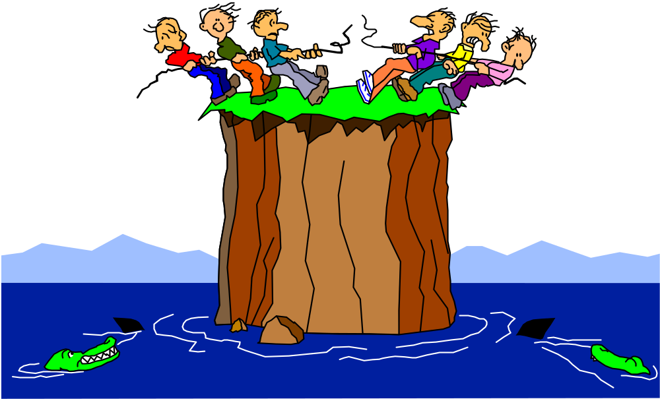
Interaction Diagrams
Lesson 04
Notes:
Lecturer: Nguyễn Trần Thi Văn
Software Development Environments and Tools

Slide 3
Sequence Diagrams
Notes:
Lecturer: Nguyễn Trần Thi Văn
Software Development Environments and Tools

Slide 4
What are Interaction Diagrams?
  An interaction diagram is a graphical representation of interactions between objects
  There are two kinds of interaction diagrams
    Sequence diagrams
    Collaboration (communication) diagrams
  Each provides a different view of the same interaction
    Sequence diagrams are time ordered
    Collaboration diagrams may include data flow
Notes:
Lecturer: Nguyễn Trần Thi Văn
Software Development Environments and Tools

Slide 5
What is a Sequence Diagram?
  A sequence diagram shows object interactions arranged in time sequence
  The diagram shows
    The objects participating in the interaction
    The sequence of messages exchanged
  A sequence diagram contains:
    Objects with their “lifelines”
    Messages exchanged between objects in ordered sequence
    Focus of control (optional)
Notes:
Lecturer: Nguyễn Trần Thi Văn
Software Development Environments and Tools

Slide 6
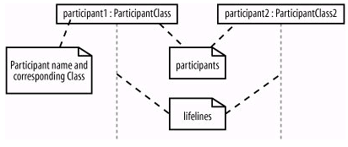
Participants
Participants in sequence diagrams are objects
Notes:
Lecturer: Nguyễn Trần Thi Văn
Software Development Environments and Tools

Slide 7
Naming Objects in Sequence Diagrams
admin | Object name, not assigned to a specific class
:BlogEntry | Object without a name, class name only
admin:Administrator | Object name with class
b [10]:BlogEntry | Array of 10 objects
:CMS ref cmsInteraction | Reference to another sequence diagram
Notes:
Lecturer: Nguyễn Trần Thi Văn
Software Development Environments and Tools

Slide 8
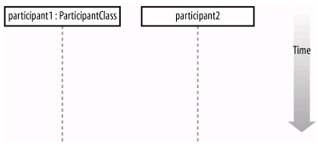
Time
Time runs down from top of the diagram
Notes:
Lecturer: Nguyễn Trần Thi Văn
Software Development Environments and Tools

Slide 9
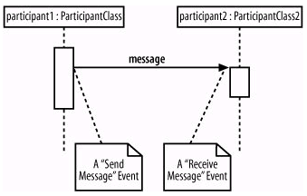
Events and Messages
Notes:
Lecturer: Nguyễn Trần Thi Văn
Software Development Environments and Tools

Slide 10
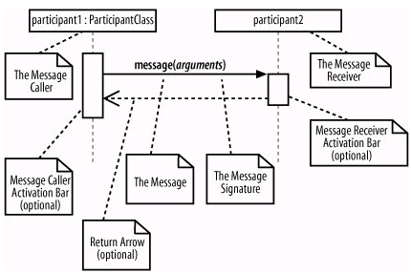
Events and Messages (2)
attribute=message_name(arguments):return_type
Notes:
Lecturer: Nguyễn Trần Thi Văn
Software Development Environments and Tools

Slide 11
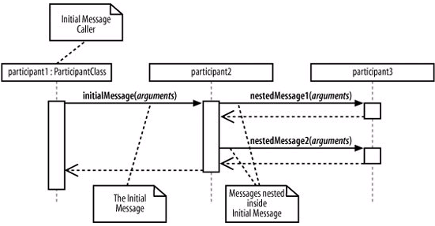
Nested messages
2 nested messages are invoked when an initial message is recieved
Notes:
Lecturer: Nguyễn Trần Thi Văn
Software Development Environments and Tools

Slide 12
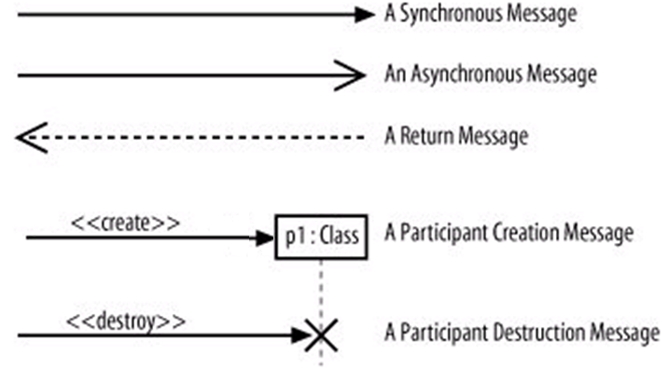
Message arrows
There are 5 types of message arrows:
Notes:
Lecturer: Nguyễn Trần Thi Văn
Software Development Environments and Tools

Slide 13
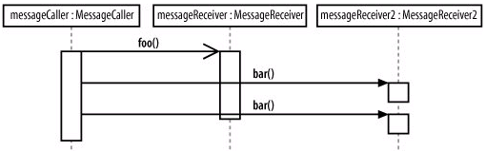
Message arrows - Async
Example:
Notes:
Lecturer: Nguyễn Trần Thi Văn
Software Development Environments and Tools

Slide 14
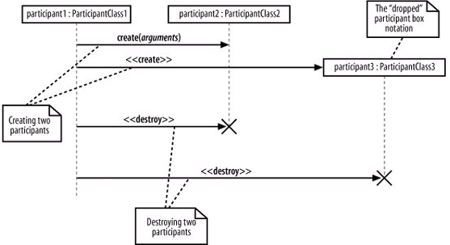
<<create>> and <<destroy>>
Notes:
Lecturer: Nguyễn Trần Thi Văn
Software Development Environments and Tools

Slide 15
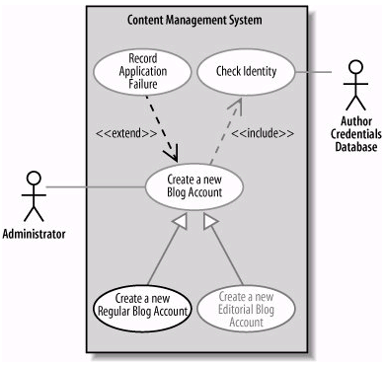
Realization of use case
  Each use case may have 1 or more sequence diagram
  Sequence diagram describe the flows of events
Notes:
Lecturer: Nguyễn Trần Thi Văn
Software Development Environments and Tools

Slide 16
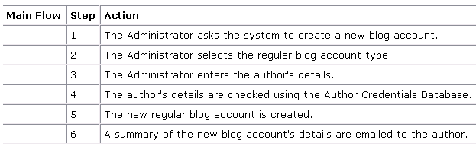
Realization of use case (2)
Create new Regular account use case
Notes:
Lecturer: Nguyễn Trần Thi Văn
Software Development Environments and Tools

Slide 17
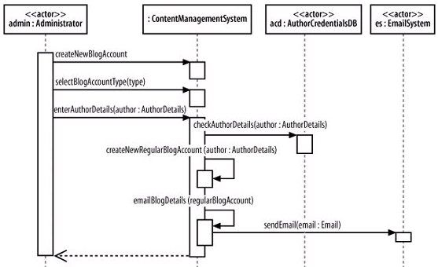
Top level sequence diagram
Notes:
Lecturer: Nguyễn Trần Thi Văn
Software Development Environments and Tools

Slide 18
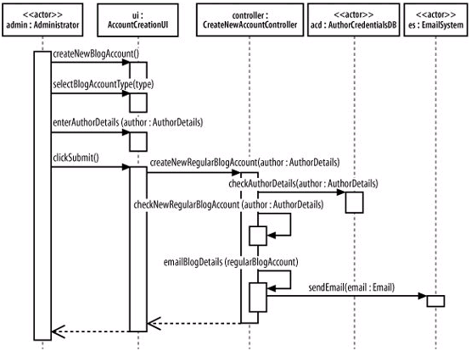
More details
Notes:
Lecturer: Nguyễn Trần Thi Văn
Software Development Environments and Tools

Slide 19
What is Focus of Control?
  Focus of Control represents the relative time that the flow of control is focused in an object
    It represents the time an object is directing messages
  Focus of Control may be shown on a sequence diagram
Notes:
Lecturer: Nguyễn Trần Thi Văn
Software Development Environments and Tools

Slide 20
Focus of Control
registration
schedule
available
John : Student
form
form
courses
1: enter id
2: validate id
3: enter current semester
4: create new schedule
5: display
6: get courses
Notes:
Lecturer: Nguyễn Trần Thi Văn
Software Development Environments and Tools

Slide 21
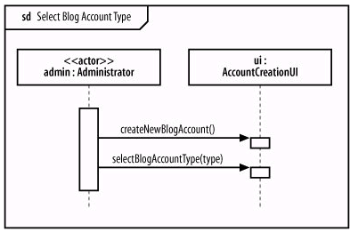
Fragments in sequence diagram
A sequence diagram may be broken into fragments
Notes:
Lecturer: Nguyễn Trần Thi Văn
Software Development Environments and Tools

Slide 22
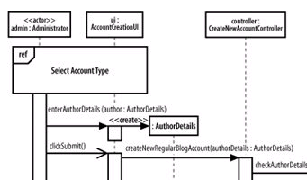
Using fragments
…
…
Notes:
Lecturer: Nguyễn Trần Thi Văn
Software Development Environments and Tools

Slide 23
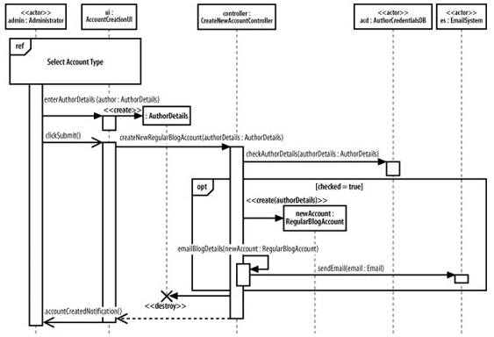
Using fragments (2)
…
Notes:
Lecturer: Nguyễn Trần Thi Văn
Software Development Environments and Tools

Slide 24
Some fragment types
  ref: an interaction defined elsewhere
  loop: repeat the interactions in the fragment many times
  break: exit the enclosing loop fragment
  alt [guard conditions]: execute the corresponding set of interactions, base on which guard condition is true
  opt [check]: optional fragment, executed only if the check value is true
Notes:
Lecturer: Nguyễn Trần Thi Văn
Software Development Environments and Tools

Slide 25
Some fragment types (2)
  par: the interactions can be executed in parallel
  region: the interactions in the fragment is said to be in a critical region (update shared paticipants)
  …
Notes:
Lecturer: Nguyễn Trần Thi Văn
Software Development Environments and Tools

Slide 26
Notes
  Notes may be added to add more information to the diagram
courses available for
the selected semester
schedule
available
form
courses
get courses
Notes:
Lecturer: Nguyễn Trần Thi Văn
Software Development Environments and Tools

Slide 27
Collaboration Diagrams
(Communication Diagrams)
Notes:
Lecturer: Nguyễn Trần Thi Văn
Software Development Environments and Tools

Slide 28
Collaboration Diagrams
A collaboration diagram is an alternate way to represent the messages exchanged by a set of objects
The diagram shows object interactions organized around the objects and their links to each other
Notes:
Lecturer: Nguyễn Trần Thi Văn
Software Development Environments and Tools

Slide 29
Collaboration Diagrams (2)
A collaboration diagram contains:
  Objects
  Links between objects
  Messages exchanged between objects
  Data flowing between objects, if any
Notes:
Lecturer: Nguyễn Trần Thi Văn
Software Development Environments and Tools

Slide 30
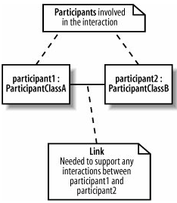

Participants, Messages and Links
Notes:
Lecturer: Nguyễn Trần Thi Văn
Software Development Environments and Tools

Slide 31
Representing Objects
  Similar to that of the sequence diagram
English
101
English 101:
Course
:Course
Object only
Object and Class
Class only
Notes:
Lecturer: Nguyễn Trần Thi Văn
Software Development Environments and Tools

Slide 32
Representing Links
  A interaction link in a collaboration diagram is represented as a line connecting object icons
  A link indicates that there is a pathway for communication between the connected objects
schedule form : Form
a course : Course
Notes:
Lecturer: Nguyễn Trần Thi Văn
Software Development Environments and Tools

Slide 33
Link Annotations
  An interaction link in a collaboration diagram can be annotated with:
    An arrow pointing from the client object to the supplier object
    The name of the message with an optional list of parameters and/or a data return value
    An optional sequence number showing the relative order with which the messages are sent
Notes:
Lecturer: Nguyễn Trần Thi Văn
Software Development Environments and Tools

Slide 34
Link Notation
Message
Arrow points from client to supplier
2: get courses
Client object
1: get prerequisites
schedule form
a course
Supplier object
Notes:
Lecturer: Nguyễn Trần Thi Văn
Software Development Environments and Tools

Slide 35
Sample Collaboration Diagram
2: validate id
1: enter id
3: enter current semester
registration form
4: create new schedule
John : Student
5: display
available classes
schedule form
6: get courses
Notes:
Lecturer: Nguyễn Trần Thi Văn
Software Development Environments and Tools

Slide 36
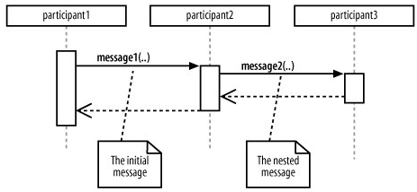
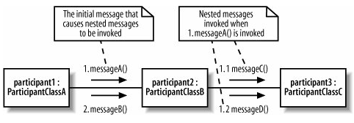
Nested messages
Notes:
Lecturer: Nguyễn Trần Thi Văn
Software Development Environments and Tools

Slide 37
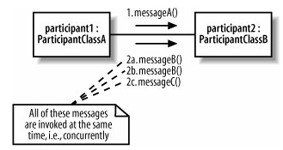
Concurrence messages
All concurrence messages have the same number, but different in the subsequent alphabetical character
Notes:
Lecturer: Nguyễn Trần Thi Văn
Software Development Environments and Tools

Slide 38
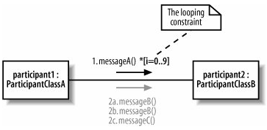
Messages invoked multiple times
Using multiplicity after the message
Notes:
Lecturer: Nguyễn Trần Thi Văn
Software Development Environments and Tools

Slide 39
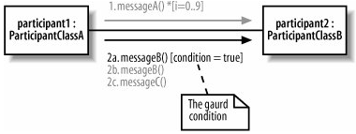
Messages based on a condition
The message can only be invoked if the condition is true
The guard
condition
Notes:
Lecturer: Nguyễn Trần Thi Văn
Software Development Environments and Tools

Slide 40
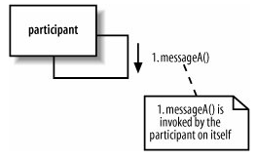
Self messages
An object may send a message to itself
Notes:
Lecturer: Nguyễn Trần Thi Văn
Software Development Environments and Tools

Slide 41
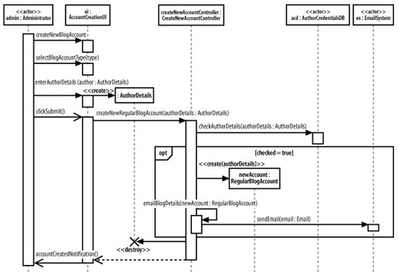
Building a collaboration diagram
1
2
3
4
5
6
7
Notes:
Lecturer: Nguyễn Trần Thi Văn
Software Development Environments and Tools

Slide 42
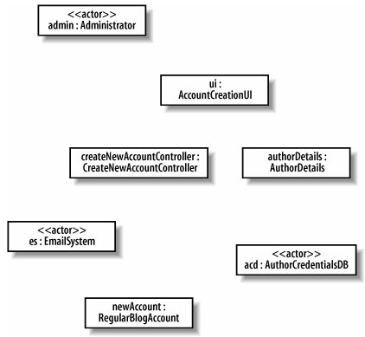
Building a collaboration diagram
Adding the participating objects into the communication diagram
Notes:
Lecturer: Nguyễn Trần Thi Văn
Software Development Environments and Tools

Slide 43
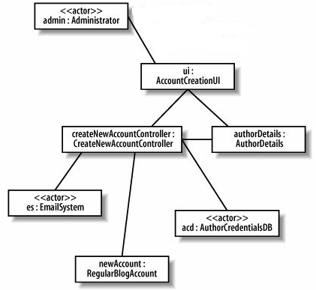
Building a collaboration diagram
Adding links required for the message passing to the communication diagram
Notes:
Lecturer: Nguyễn Trần Thi Văn
Software Development Environments and Tools

Slide 44
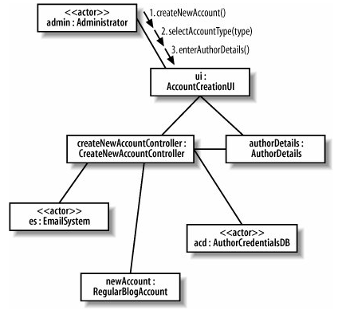
Building a collaboration diagram
3 first separate messages are passed to the ui object, one after another
Notes:
Lecturer: Nguyễn Trần Thi Văn
Software Development Environments and Tools

Slide 45

Building a collaboration diagram
The nested create message is invoked
Notes:
Lecturer: Nguyễn Trần Thi Văn
Software Development Environments and Tools

Slide 46
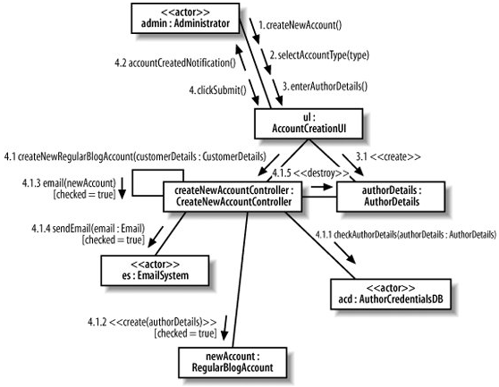
Building a collaboration diagram
And so on, until we finish adding all the messages into the diagram
Notes:
Lecturer: Nguyễn Trần Thi Văn
Software Development Environments and Tools

Slide 47
Summary: Object Interaction
  Object interaction can be represented graphically in a sequence diagram which shows the existence of objects and the interactions between the identified objects
    Objects are represented by rectangles with underlined names
    An object “lifeline” is represented by dashed vertical lines descending from the object
Notes:
Lecturer: Nguyễn Trần Thi Văn
Software Development Environments and Tools

Slide 48
Summary: Object Interaction (2)
    Messages are indicated by horizontal arrows which are directed from the client object (sender) to the supplier object (receiver)
    The horizontal arrows are labeled with the message name
    An optional script may be added to provide more detail to the diagram
Notes:
Lecturer: Nguyễn Trần Thi Văn
Software Development Environments and Tools

Slide 49
Summary: Object Interaction (3)
  A collaboration diagram is an alternate graphical representation of object interactions
    Objects are represented by rectangles
    An interaction link (line) is drawn between communicating objects
      The link is annotated with an arrow containing the message name which points from the client object to the supplier object
      The link may also be annotated with a data return arrow
Notes:
Lecturer: Nguyễn Trần Thi Văn
Software Development Environments and Tools

Slide 50
Summary: Object Interaction (4)
  Sequence diagram vs Collaboration diagram
    Show participants?
    Show links?
    Show message signatures?
    Show parallel messages?
    Show asynchronous messages?
    Show message order?
    Easy creation and maintaining?
Notes:
Lecturer: Nguyễn Trần Thi Văn
Software Development Environments and Tools

Slide 51

Notes:
63
Lecturer: Nguyễn Trần Thi Văn
Software Development Environments and Tools

Slide 52
THE END
Notes:
Lecturer: Nguyễn Trần Thi Văn
Software Development Environments and Tools

